Slide 1


Front End
HTML/CSS/JS

Slide 2


HTML
It is like a skeleton.

Slide 3

And CSS
Its the style

Slide 4
Learning HTML and CSS
Step 1 — Learn Basics of HTML and CSS
Step 3 — Understand HTML Layouts
https://www.codementor.io/css/tutorial/4-different-layout-techniques-create-single-page
http://learnlayout.com/
http://www.w3schools.com/html/default.asp
http://www.w3schools.com/css/
Step 2 — Learn by Doing
Step 4 — Understand HTML Forms
https://www.codecademy.com/learn/web
http://learn.shayhowe.com/html-css/building-forms/
http://www.javascript-coder.com/html-form/html-form-tutorial-p1.phtml

Slide 5
Go Further
Step 8 — Best Practices
Step 5 — Understand CSS Positioning
http://learn.shayhowe.com/html-css/writing-your-best-code/
https://code.tutsplus.com/tutorials/30-css-best-practices-for-beginners--net-6741
https://www.codecademy.com/courses/advanced-css-positioning/0/1
http://learn.shayhowe.com/advanced-html-css/detailed-css-positioning/
Step 6 — Build a project using HTML and CSS
http://www.theodinproject.com/courses/web-development-101/lessons/html-css
Step 9 — Testing time — Assignments
http://www.landofcode.com/html-exercises/
http://www.landofcode.com/css-examples/
Step 7 — Learn about Responsive
http://www.w3schools.com/css/css_rwd_grid.asp
Step 10 — Additional Resources
https://www.zeolearn.com/magazine/html-and-css-resources-stepping-into-web-development

Slide 6
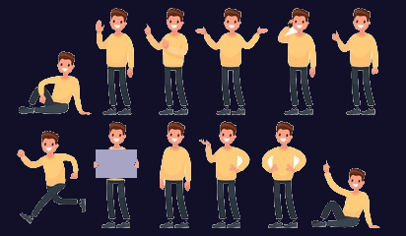
HTML + CSS + Javascript:
It gives the interactions.

Slide 7
Learn Basic Js
An introduction
Code quality
Object properties configuration
https://javascript.info/getting-started
https://javascript.info/code-quality
https://javascript.info/object-basics
JavaScript Fundamentals
Data types
Prototypes, inheritance
https://javascript.info/first-steps
https://javascript.info/data-types
https://javascript.info/prototypes
Advanced working with functions
Classes
https://javascript.info/advanced-functions
https://javascript.info/classes

Slide 8


Going Further
Browser: Document, Events, Interfaces
https://javascript.info/document
UI Events
https://javascript.info/mouse-events-basics
Frames and windows
https://javascript.info/frames-and-windows

